Slide 1
UNIT 3
Display Devices, Light Sources and Detection Devices
Prepared By Dr.Christeena Joseph
Associate Professor
Department of ECE

Slide 2
Luminescence
Luminescence
Luminescence is spontaneous emission of light by a substance not resulting from heat; or "cold light".
It is thus a form of cold-body radiation. It can be caused by chemical reactions, electrical energy, subatomic motions or stress on a crystal. This distinguishes luminescence from incandescence, which is light emitted by a substance as a result of heating.

Slide 3
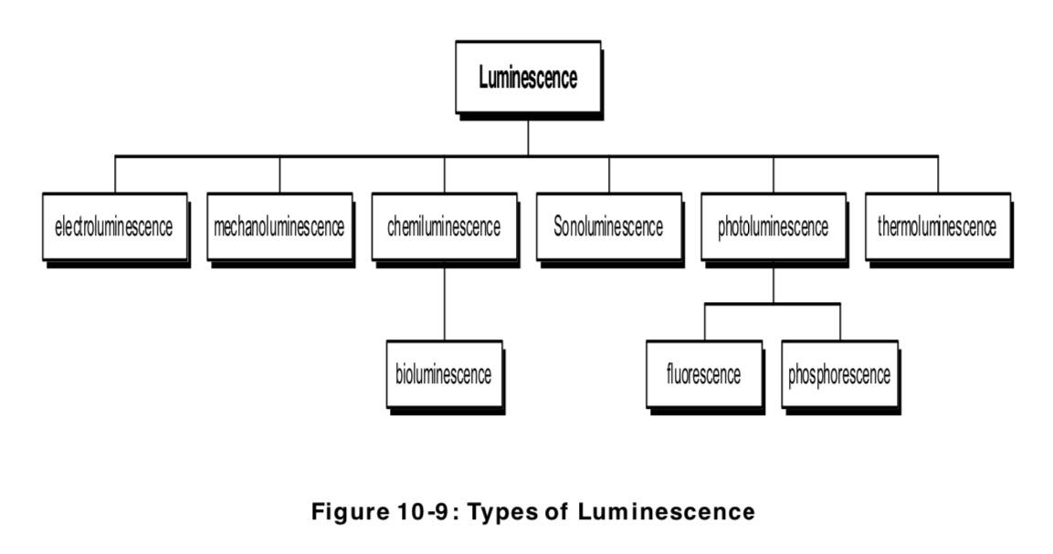

Slide 4
A material that emits light is called luminescent material
It emits energy from an excited electronic state as light.
Some of the incident energy is absorbed and re-emitted as light of a longer wavelength.
The wavelength of the emitted light is characteristic of the luminescent substance and not of the incident radiation.
The emitted light carries the materials signature.

Slide 5
Photo luminescence
Photoluminescence (PL) is a process in which the substance absorbs photons (EM radiation) and then re-radiates photons.
The radiated light is often visible, but can also be in the ultraviolet or infrared spectral region.
The term embraces both fluorescence and phosphorescence, which differ in the time after irradiation over which the luminescence occurs.

Slide 6
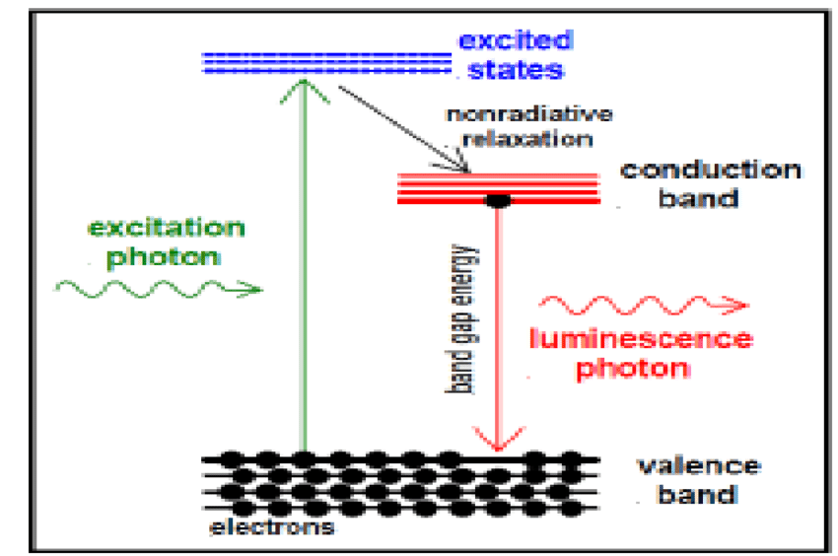

Slide 7
Photoluminescence in semiconductors and dielectrics can usually only occur for illumination of a substance with light which has a photon energy above the band gap energy.
The photoluminescence usually occurs for wavelengths around the band gap wavelength.
In many cases, photoluminescence occurs only with certain dopants or impurities in a material.
For example, fluorescence can occur when rare-earth-doped laser gain media are pumped with light which can excite the rare earth ions. Here, the emission can occur in various wavelength bands corresponding to optical transitions of those ions.
One may obtain more than one photon per absorbed photon, when there is a cascade of transitions.
Photoluminescence may be largely suppressed (quenched) if there are fast non-radiative transitions to lower energy levels, leading to a very small lifetime of the excited levels..

Slide 8
Fluorescence is a short-lived photoluminescence, excited by irradiation of a substance with light.
The light hitting a sample puts atoms, ions or molecules in the sample into excited states (by absorption of photons), from where they decay into lower-lying states (e.g. their ground states) through spontaneous emission of fluorescence photons.
This phenomenon is exploited for illumination, particularly in fluorescent lamps.
It also occurs at a side effect in various kinds of optically pumped lasers and amplifiers, e.g. in solid-state doped-insulator lasers and amplifiers (including fiber lasers and fiber amplifiers), in optically pumped semiconductor lasers, and in dye lasers. The resulting radiation is called fluorescent light.

Slide 9
Phosphorescence is a kind of luminescence (i.e., a kind of light emission of a medium) which lasts relatively long after excitation of the medium with light (for example many milliseconds or more).
The excitation energy is stored in metastable electronic states(excited states (particularly electronic states in laser gain media) which have a relatively long lifetime due to slow radiative and non-radiative decay), exhibiting only forbidden transitions to lower states.
There are also cases with delayed fluorescence.
As the stored energy can be released only through relatively slow processes, phosphorescence is generally much weaker than fluorescence.
Important phosphorescent materials are europium-doped strontium aluminate (Eu²⁺:SrAl₂O₄) and zinc sulfide (Eu²⁺:ZnS).
They are used e.g. in safety products such as exit signs, which are visible even under conditions of power failure, although they are not very bright.

Slide 10
Photoluminescence is sometimes used for the characterization of photonic devices or parts thereof.
For example, one may irradiate a semiconductor wafer, on which additional layers for a semiconductor laser or a saturable absorber(light absorbers with a degree of absorption which is reduced at high optical intensities) have been fabricated, with short-wavelength light for exciting photoluminescence.
The optical spectrum(the decomposition of the power or energy of light according to different wavelengths or optical frequencies) of the photoluminescence (PL spectrum) and also the dependence of its intensity on the irradiation intensity and device temperature can deliver important information for device characterization.
In particular, PL spectra and their intensity dependencies can allow one
to determine the band gap energy
to estimate the wavelength of maximum gain
to determine the composition of ternary or quaternary layers
to determine impurity levels to investigate recombination mechanisms

Slide 11
Cathodoluminescence
Cathodoluminescence is an optical and electromagnetic phenomenon in which electrons impacting on a luminescent material such as a phosphor, cause the emission of photons which may have wavelengths in the visible spectrum.
A familiar example is the generation of light by an electron beam scanning the phosphor-coated inner surface of the screen of a television that uses a cathode ray tube.
Cathodoluminescence is the inverse of the photoelectric effect, in which electron emission is induced by irradiation with photons.

Slide 12
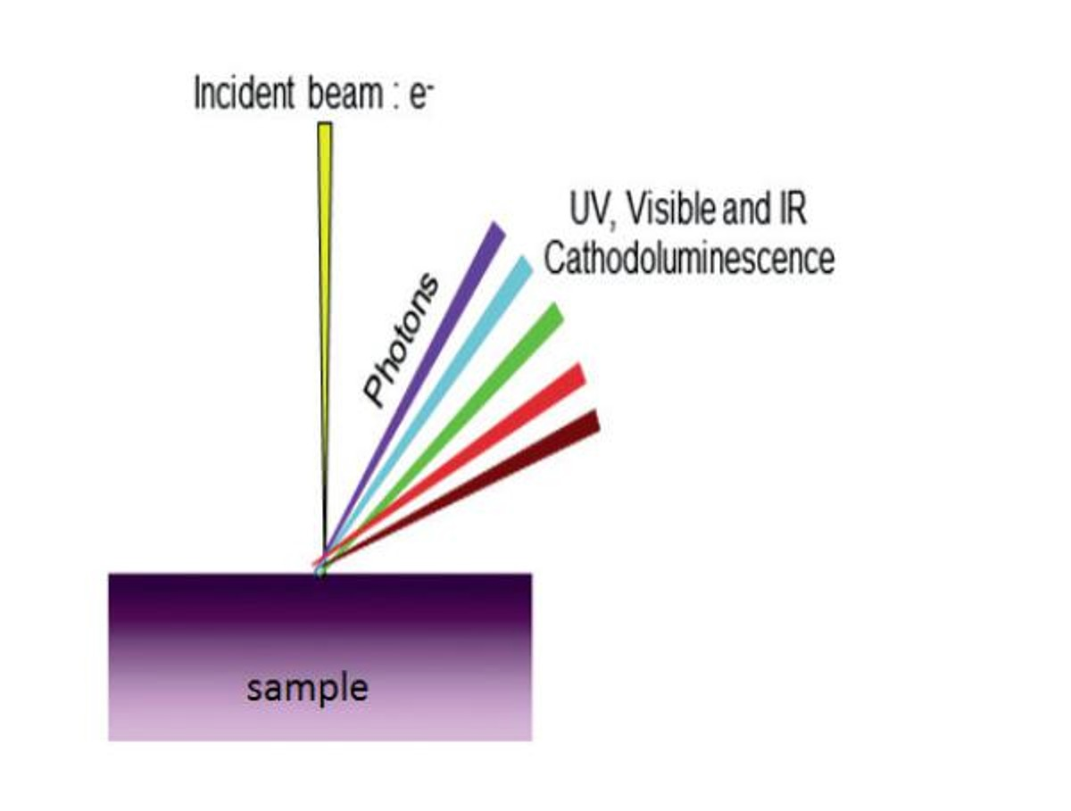

Slide 13
Luminescence in a semiconductor results when an electron in the conduction band recombines with a hole in the valence band. The difference energy (band gap) of this transition can be emitted in form of a photon.
The energy (color) of the photon, and the probability that a photon and not a phonon will be emitted, depends on the material, its purity, and the presence of defects.
First, the electron has to be excited from the valence band into the conduction band. In cathodoluminescence, this occurs as the result of an impinging high energy electron beam onto a semiconductor.
However, these primary electrons carry far too much energy to directly excite electrons. Instead, the inelastic scattering of the primary electrons in the crystal leads to the emission of secondary electrons, Auger electrons and X-rays, which in turn can scatter as well. Such a cascade of scattering events leads to up to 10³ secondary electrons per incident electron.
These secondary electrons can excite valence electrons into the conduction band when they have a kinetic energy about three times the band gap energy of the material.s
From there the electron recombines with a hole in the valence band and creates a photon. The excess energy is transferred to phonons and thus heats the lattice.

Slide 14
Cathodoluminescence Applications
Cathodoluminescence emission can be used to explore many fundamental properties of matter.
It can be used to study light transport, scattering, electronic structure of materials, including semiconductors, (e.g. bandgap, defects), resonant phenomena.
Cathodoluminescence imaging is also an ideal tool to study geological samples. The CL emission from a rock gives insights into crystal growth, zonation, cementation, replacement, deformation, provenance, trace elements, and defect structures

Slide 15
INJECTION LUMINESCENCE
If a p-n junction diode is forward biased, the majority carriers from both sides cross the junction and enter the opposite sides.
This results in an increase in the minority carrier concentration on the two sides.
The excess minority carrier concentration, of course, depends on the impurity levels on the two sides.
This process is known as minority carrier injection.
The injected carriers diffuse away from the junction, recombining with majority carriers as they do so.
This recombination process of electrons with holes may be either nonradiative, in which the energy difference of the two carriers is released into the lattice as thermal energy, or radiative, in which a photon of energy equal to or less than the energy difference of the carriers is radiated.
The phenomenon of emission of radiation by the recombination of injected carriers is called injection luminescence. A p-n junction diode exhibiting this phenomenon is referred to as a light-emitting diode.

Slide 16
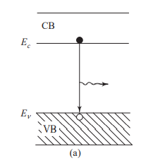
Radiation may be emitted via
i)The recombination of an electron in the CB with a hole in the VB .

Slide 17
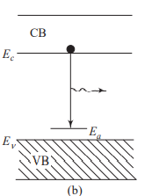
ii)The downward transition of an electron in the CB to an empty acceptor level, shown in Fig.

Slide 18
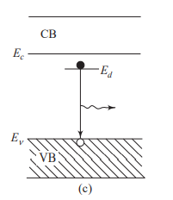
iii) The transition of an electron from a filled donor level to a hole in the VB, shown in Fig.

Slide 19

Spectrum of Injection Luminescence
If the transition takes place from the electron level at the bottom of the CB to the hole level at the top of the VB, the emitted photon will have energy
where h is Planck’s constant, c is the speed of light, and l is the wavelength of emitted radiation.
However, there is a distribution of electron energy levels in the CB and that of holes in the VB.
Thus, depending on the energy levels involved, there will be a range of photon energies that are emitted by the LED

Slide 20

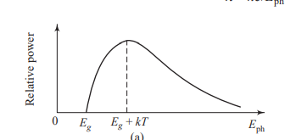
The spectral distribution of the radiated power P as a function of Eph is given by the following expression:
where α is a constant. The theoretical plot of relative power versus E_{ph} is shown in Fig

Slide 21
Electro luminescence
Electroluminescence (EL) is an optical phenomenon and electrical phenomenon in which a material emits light in response to the passage of an electric current or to a strong electric field.
Electroluminescence is the result of radiative recombination of electrons & holes in a material, usually a semiconductor.
The excited electrons release their energy as photons - light. Prior to recombination, electrons and holes may be separated either by doping the material to form a p-n junction (in semiconductor electroluminescent devices such as light-emitting diodes) or through excitation by impact of high-energy electrons accelerated by a strong electric field (as with the phosphors in electroluminescent displays).

Slide 22
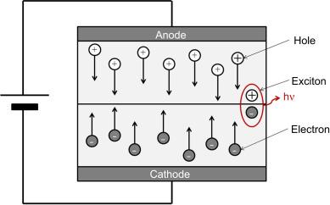

Slide 23
Electroluminescent devices are fabricated using either organic or inorganic electroluminescent materials. The active materials are generally semiconductors of wide enough bandwidth to allow the exit of the light.
The most typical inorganic thin-film EL (TFEL) is ZnS:Mn with yellow-orange emission. Examples of the range of EL material include:
Powdered zinc sulfide doped with copper (producing greenish light) or silver (producing bright blue light)
Thin-film zinc sulfide doped with manganese (producing orange-red color)
Naturally blue diamond, which includes a trace of boron that acts as a dopant.
Semiconductors containing Group III and Group V elements, such as indium phosphide (InP), gallium arsenide (GaAs), and gallium nitride (GaN) (Light-emitting diodes)

